Slide 1
LECTURE 02: VISUALIZATION FUNDAMENTALS PT. 1
September 13, 2016
SDS 136
Communicating with Data

Slide 2


Announcements
Introducing our illustrious SDS136 TAs!
Subashini Sridhar, ‘18J Grace Zhan, ‘18
ssridhar@smith.edu gzhan@smith.edu
TA hours for this course will be scheduled later this week, keep an eye on Piazza

Slide 3

Preparing for labs
Our labs will be run using Tableau, a drag-and-drop visualization tool suite
Tableau for Teaching has donated license keys (good for one year) for everyone enrolled in this course
Instructions for getting a license have been posted to Piazza; please install before Thursday!
Need help? Ping me or the TAs, or come to office hours

Slide 4
Outline
A quick history lesson
Mental models: how we process information
Visualization building blocks
Takeaways

Slide 5
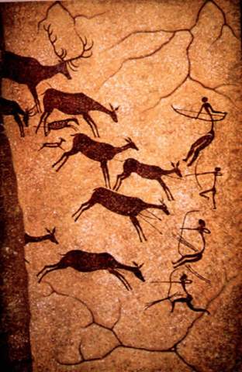
(Incomplete) History of Visualization: 15,000BC
15,000 BC. Laxcaux, France

Slide 6
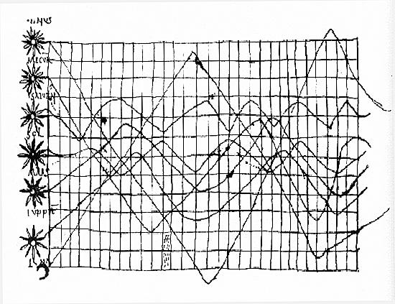
(Incomplete) History of Visualization: 900s
Oldest known attempt to show changing values graphically
Inclinations of the planetary orbits over time

Slide 7
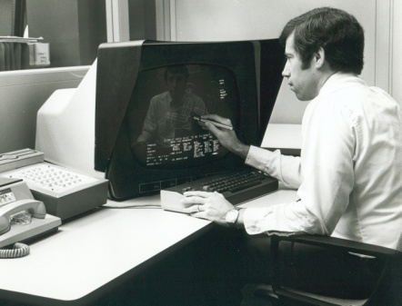
(Incomplete) History of Visualization: 1970s
CAD/CAM, building cars, planes, chips
Starting to think about: 3D, animation, edu, medicine

Slide 8
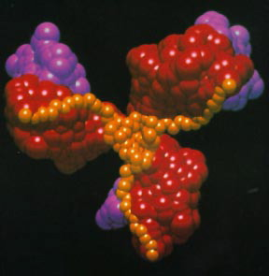
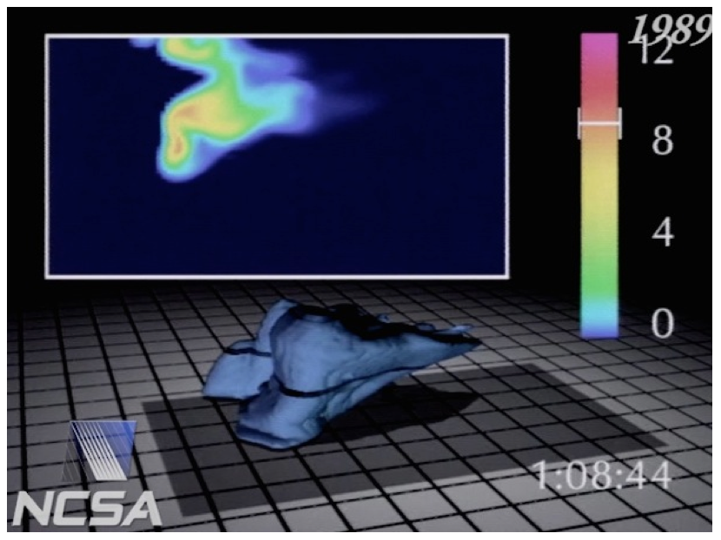
(Incomplete) History of Visualization: 1980s
Scientific visualization, physical phenomena
Starting to think about: photorealism, entertainment

Slide 9
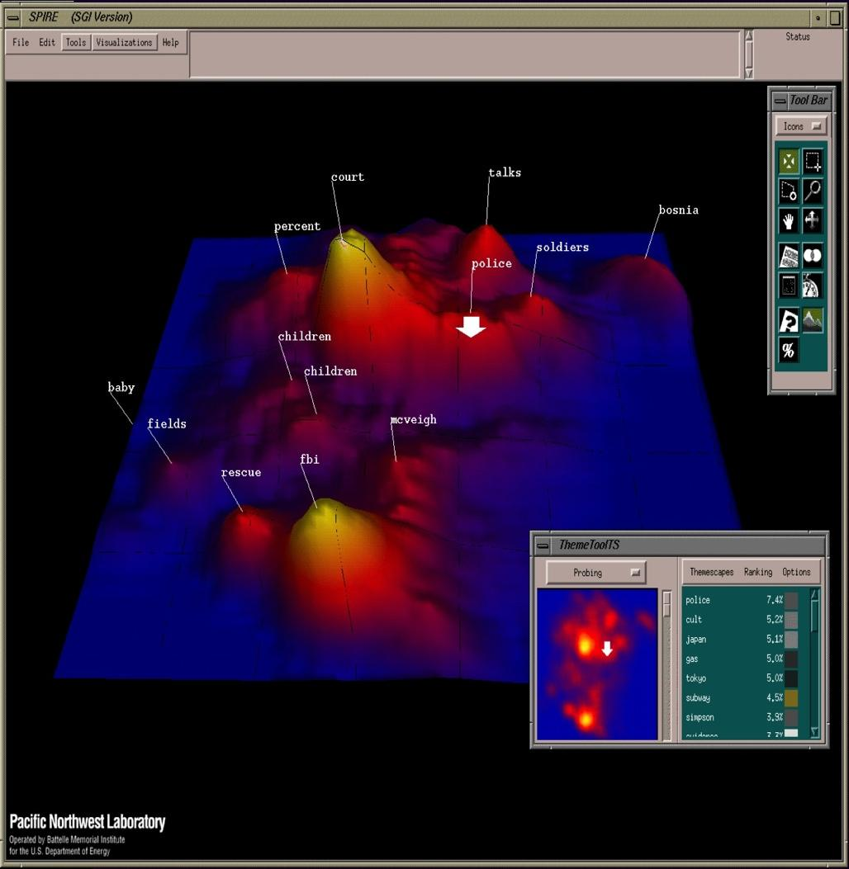
(Incomplete) History of Visualization: 1990s
Information visualization, storytelling
Starting to think about: online spaces, interaction

Slide 10
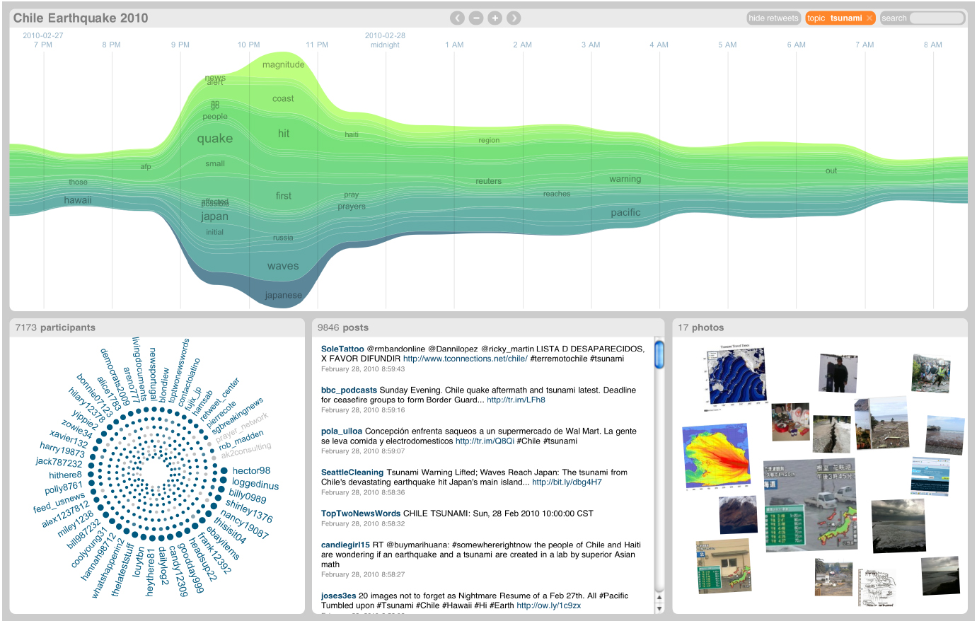
(Incomplete) History of Visualization: 2000s
Coordination across multiple views, interaction
Starting to think about: sensemaking, provenance

Slide 11
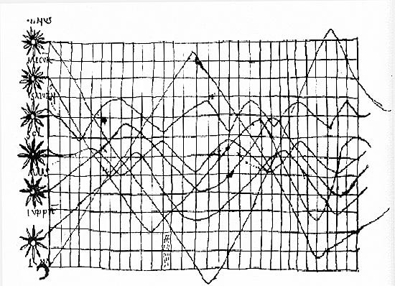
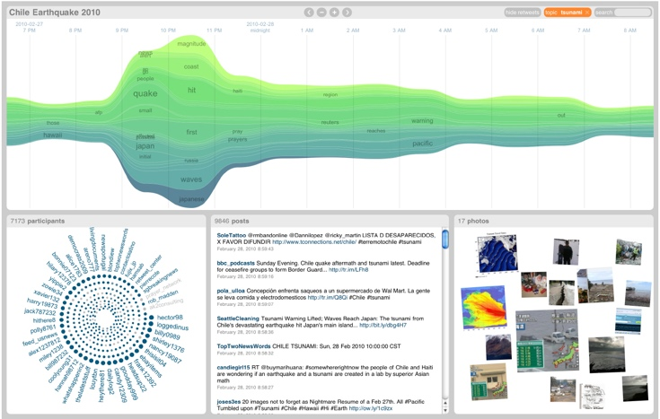
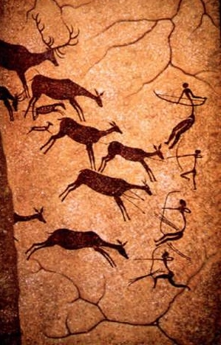
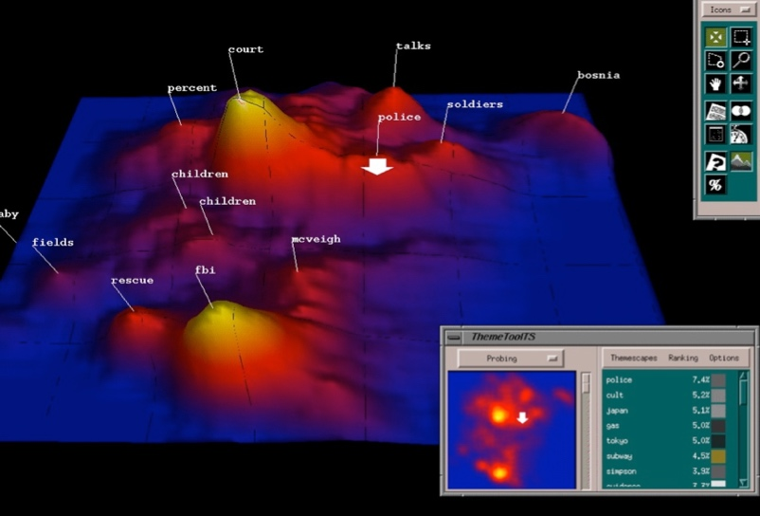

Discussion: what are they all trying to do?

Slide 12

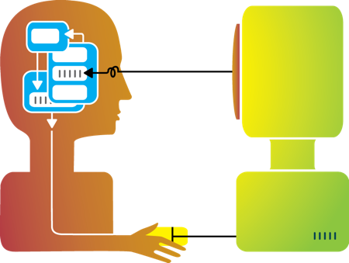
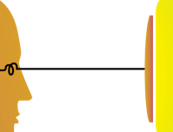
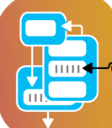
Visualization helps shape mental models
Visualization

Slide 13
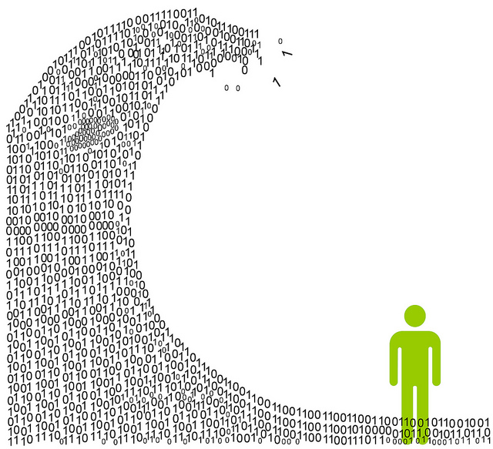
Information overload
We are exposed to huge amounts of information all the time
So much, in fact, that we can’t process it all fast enough

Slide 14

Mental models
To cope, we construct mental models: abstracted, simplified versions of the world that are more manageable

Slide 15

The 9-dot problem
Task 1: Connect all 9 dots using only straight lines

Slide 16
The 9-dot Problem
Task 2: Connect all 9 dots using 4 straight lines

Slide 17
The 9-dot Problem
Task 3: Connect all 9 dots using 3 straight lines

Slide 18
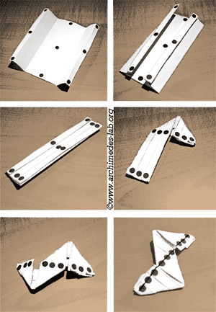
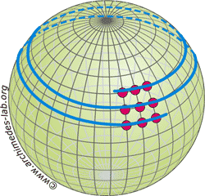
The 9-dot Problem
Task 4: Connect all 9 dots using 1 straight line

Slide 19

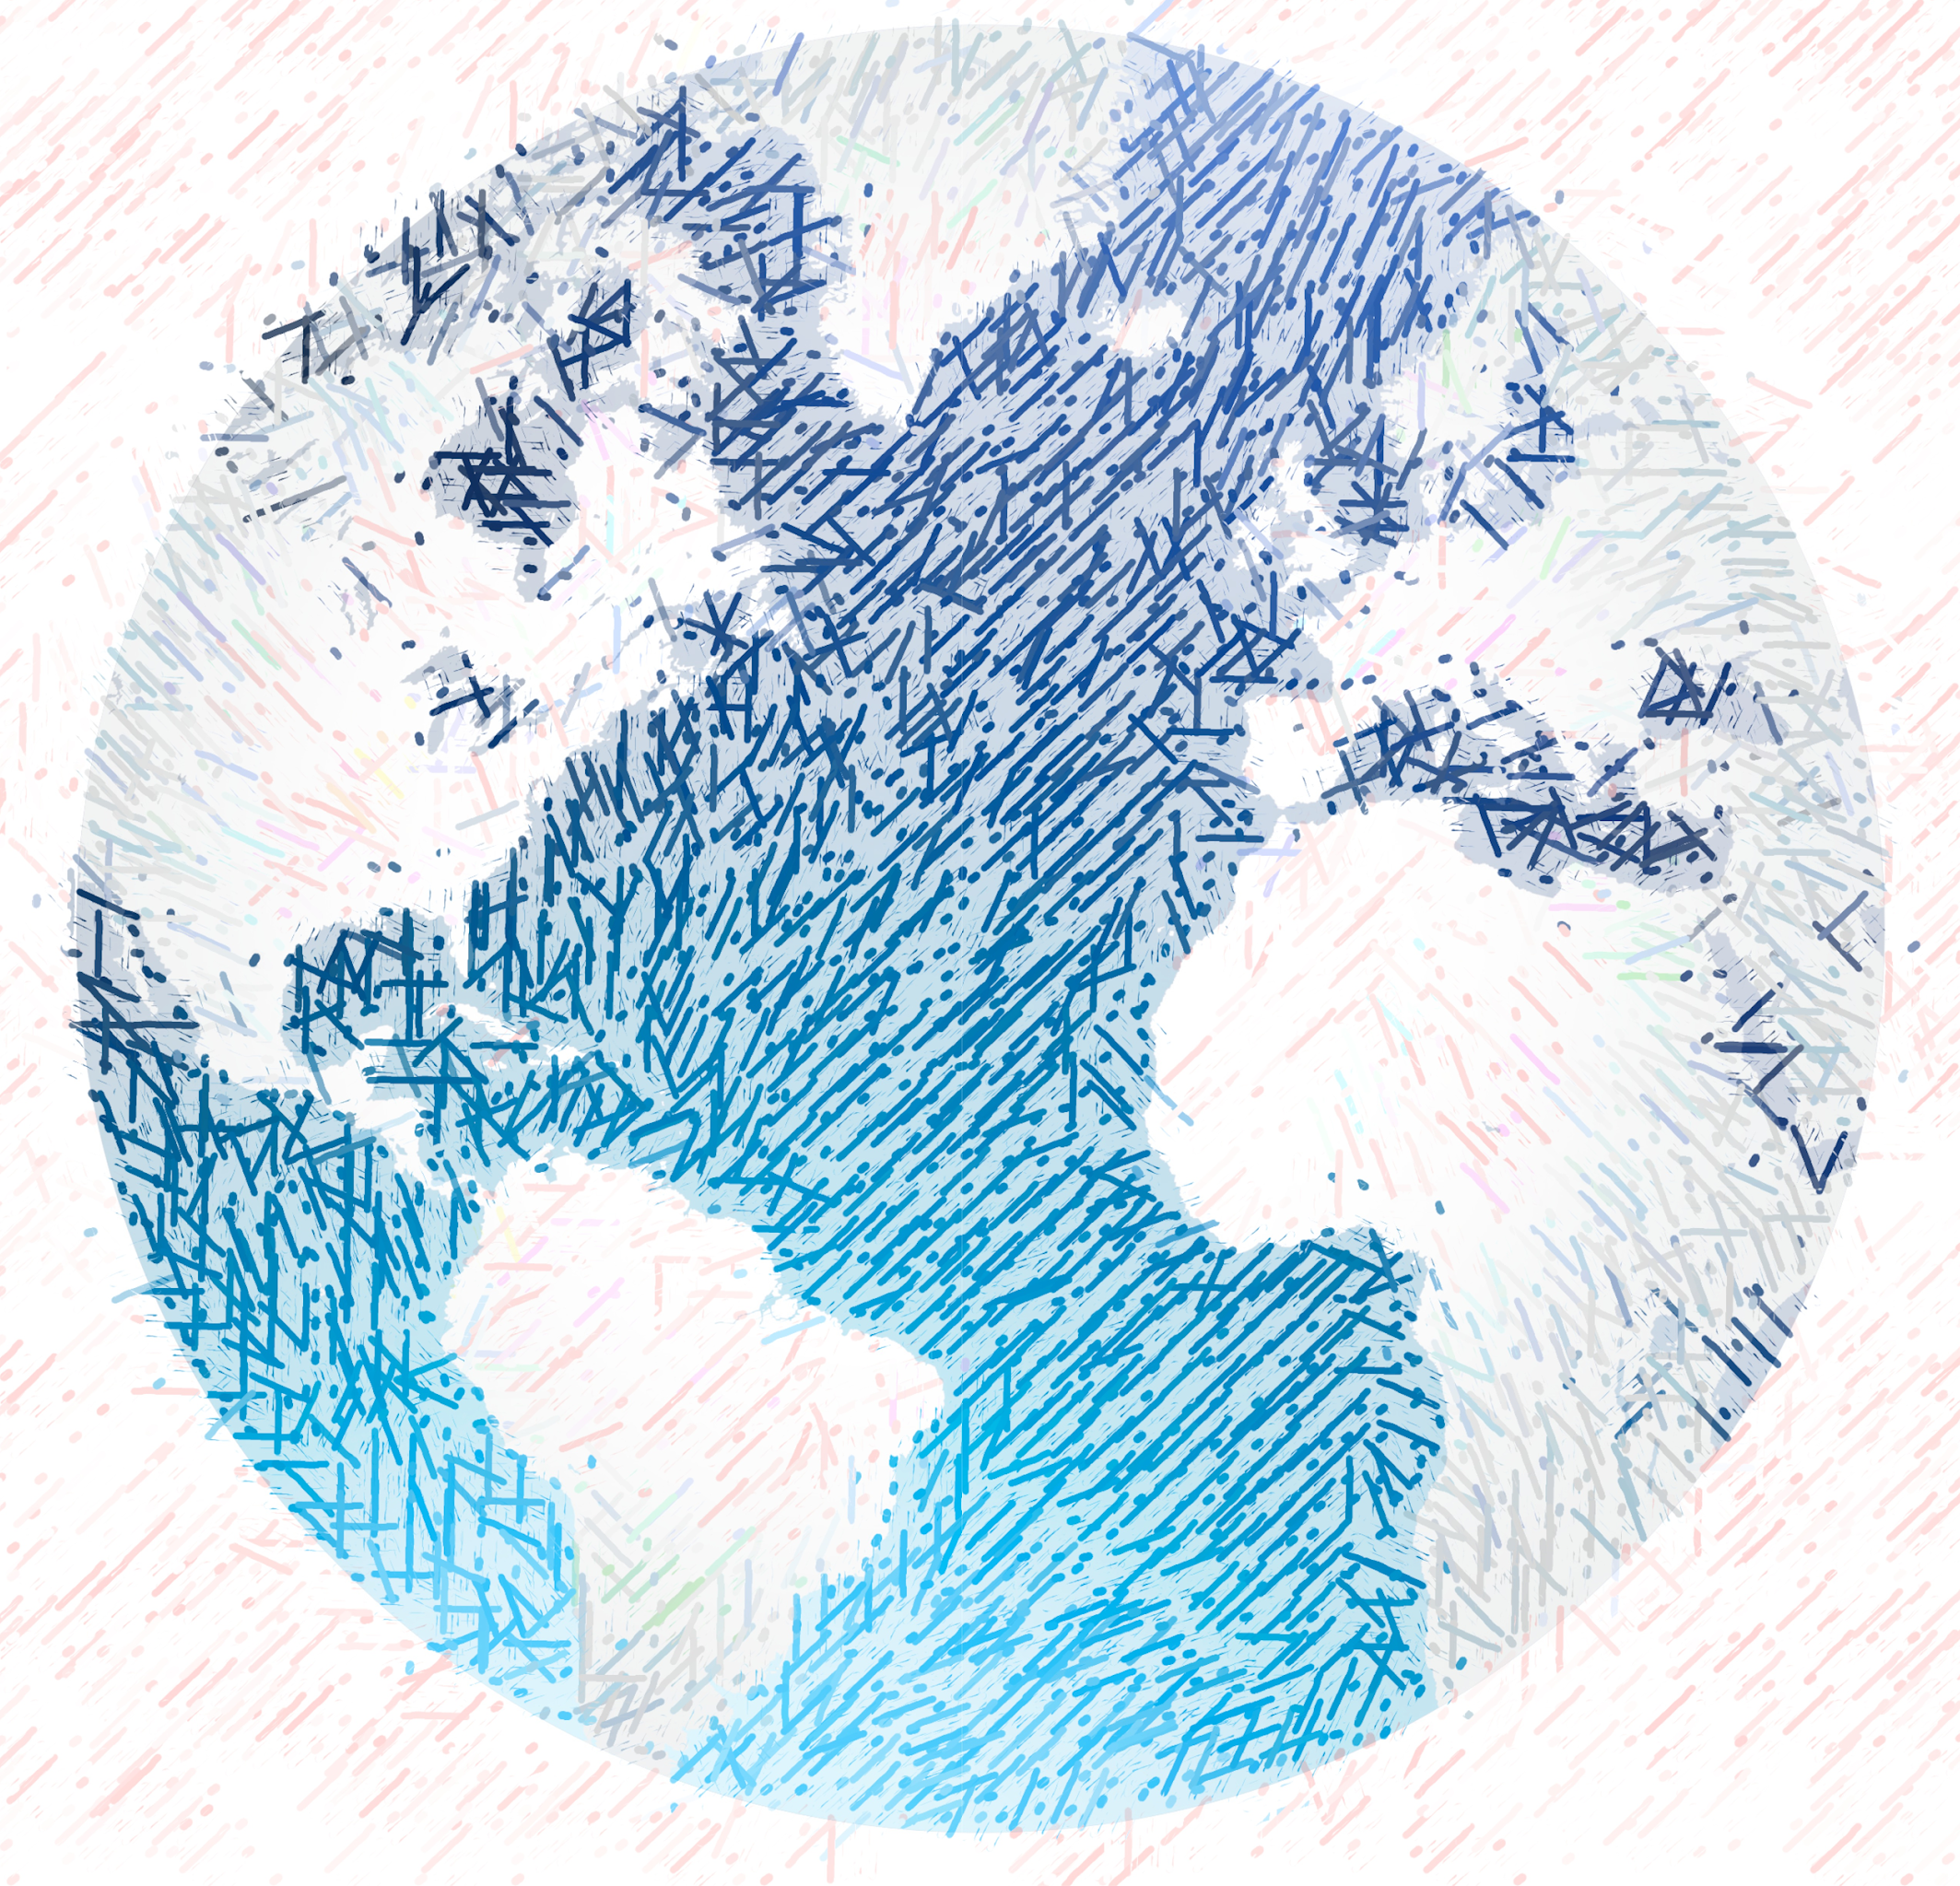

Mental Models: a Sketch

Slide 20
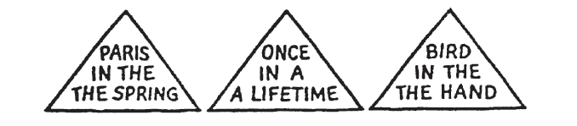
1. We tend to see what we expect to see
Mental models are built from prior experience
We expect new input to “fit” the existing model
Updates are expensive: given input that almost fits, we’ll distort information to avoid re-fitting the model
Expectation is at least as strong as perception

Slide 21
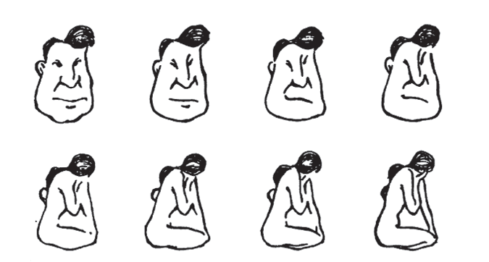
2. Mental models form quickly, & update slowly
“First impressions matter”
Early information can have the highest impact
The order in which we present pieces of information can shape how a person understands the whole
Once a mental model is formed, it takes effort to alter it

Slide 22
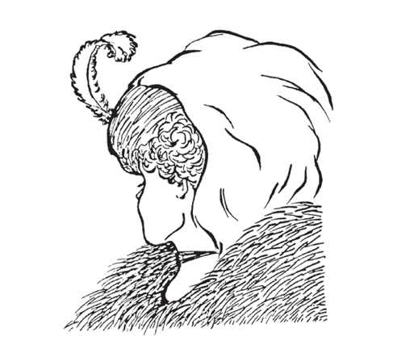
3. New information gets incorporated into the existing model
Integrating competing perspectives is challenging
Switching between multiple perspectives is also difficult (visually or mentally)
Tricky part: real-world problem often require such perspective switching

Slide 23



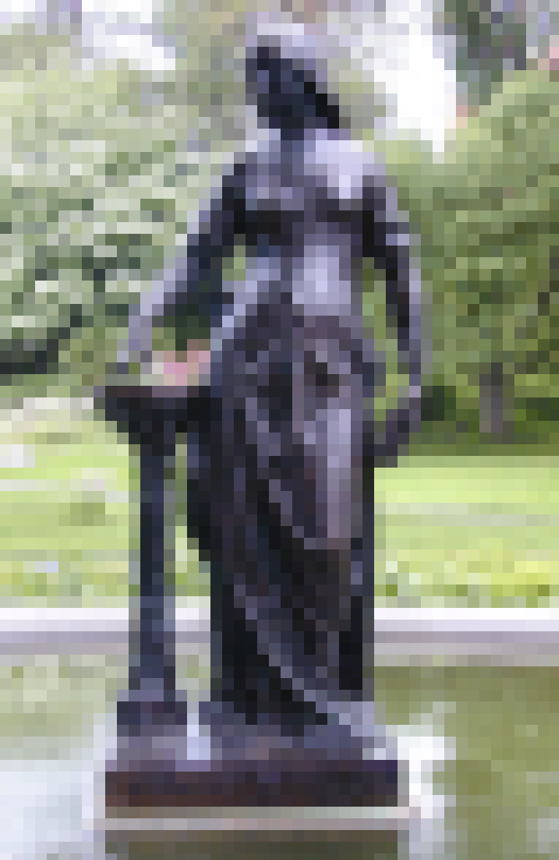


4. Initial exposure interferes with accurate perception
Blur size
128px
64px
32px
16px
8px
None

Slide 24
4. Initial exposure interferes with accurate perception
Longer exposure to ambiguous data makes people more confident in their initial model
This is true even if new data presents strong evidence that their model is wrong!
Important: need to be intentional when we design, because incremental information can be misleading

Slide 25
The good, the bad, and the ugly…
The good:
Well-tuned mental models let us process information quickly
Frees up more processing power to synthesize information
The bad:
People (esp. experts) tend not to notice information that contradicts their mental model
A “fresh pair of eyes” can be beneficial
The ugly:
Mental models are unavoidable: everyone has them, and they’re all different
Key: be aware of how mental models form, how they shape perception, and how to support (or challenge) them

Slide 26
So what do we have to work with?

Slide 27

Graphical primitives
The images we draw are composed of marks: like ink
Lines
Points
Areas

Slide 28
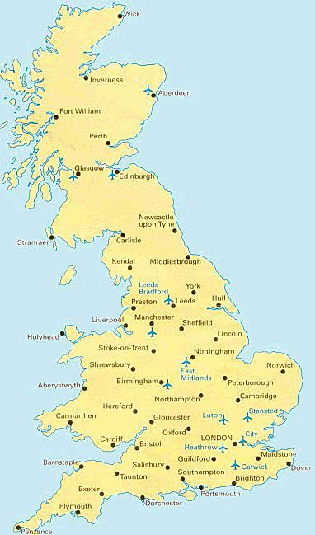
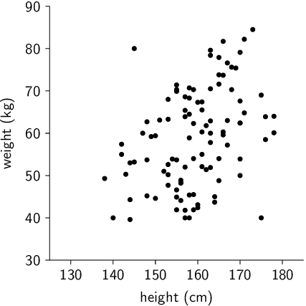
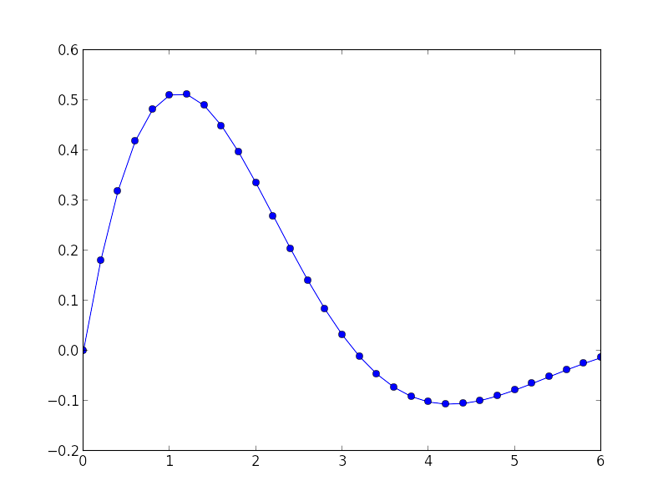
Visual dimension: position
Encode information using where the mark is drawn
Some examples:

Slide 29
Before next class
Email Jordan if you don’t have a computer that will support Tableau
If you haven’t already done so, post your first Piazza reflection:
What was one thing about today’s class
that surprised you?
What is one question you have
that you hope we’ll answer this semester?

Slide 30
Up next
Mini-lecture and lab: Introduction to
Next week: first visit to the Smith College Museum of Art

